Slide 1
MediCrystals co.
Navigating Pandemic Supply Challenges
Team ID: 2230672

Slide 2
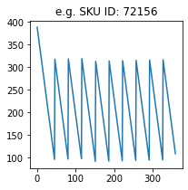
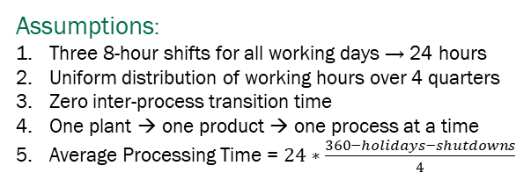
Executive Summary
Supplier Risk Management
Inventory Management
Capacity Management
Objectives
Comprehensive Supplier Risk Rating
Review Mitigation Strategies
Objectives
Calculate Obsolete Inventory
Find Change in Inventory Position
Objectives
Justify Capacity constraint Opinions
Maximize Capacity Utilization
Model: Analytic Hierarchy Process
Model: Deterministic Demand
Model: 3-Step Decision Tree
Rating Methodology (AHP)
Risks accounted
Recommended
Parameters:
Inventory Level
Production Planning
Strategies:
Available processing time at each unit fulfils the production plan
Financial
Economic Order Quantity
Order Aggregation
Chase Demand Strategy
Level Capacity Strategy
Sourcing Portfolio
Regulatory
Upper bound on units
of each product in a Quarter
Operational
Optimal schedule for 3 products has makespan ≤ 90 days
Mitigation Strategies
Constant APU after considering trend_{APU}
Initial On order Inventory = 0
Geographical
Reason: Model considered is Deterministic Demand. This is based on the forecasting methods followed in SCMs of fragile goods.
Reason: No explicit data mentioned in Exhibit 2
Assumptions
Assumptions:
Three 8-hour shifts for all working days → 24 hours
Uniform distribution of working hours over 4 quarters
Zero inter-process transition time
One plant → one product → one process at a time
Average Processing Time = $24∗\frac{360−holidays−shutdowns}{4}$
Assumptions:
Given is the exhaustive list of suppliers relevant to MediCrystals Co.
External country-specific risk factors and data can be taken into account
Initial and Final Back order Inventories = 0
Reason: No data in Exhibit 2 regarding
Initial Back order Inventory
Final Lead Time after considering S-OTD thus leading to no specific way to simulate arrival delay in model

Slide 3
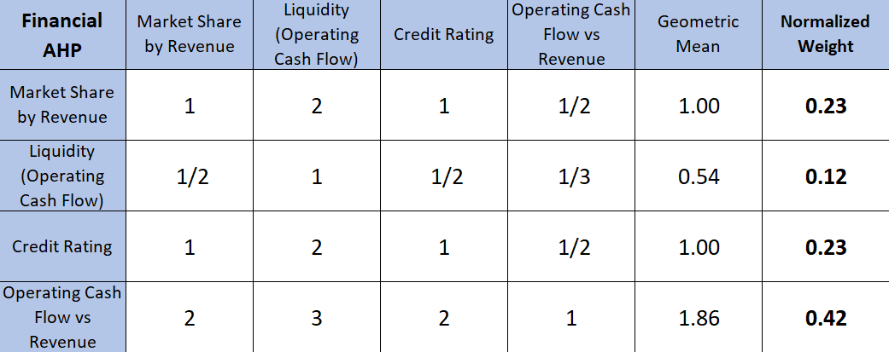
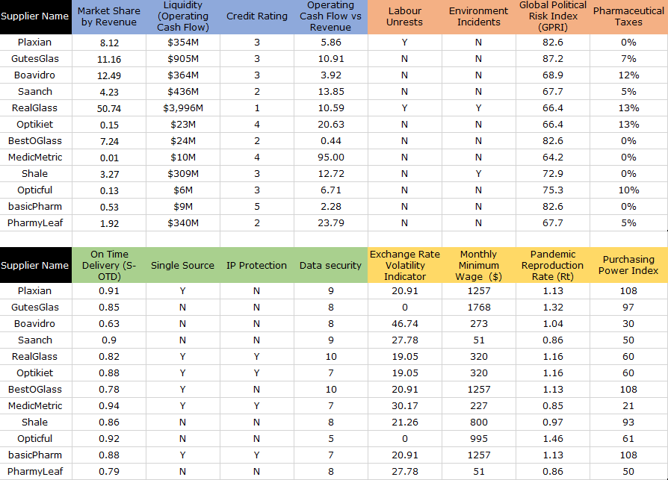
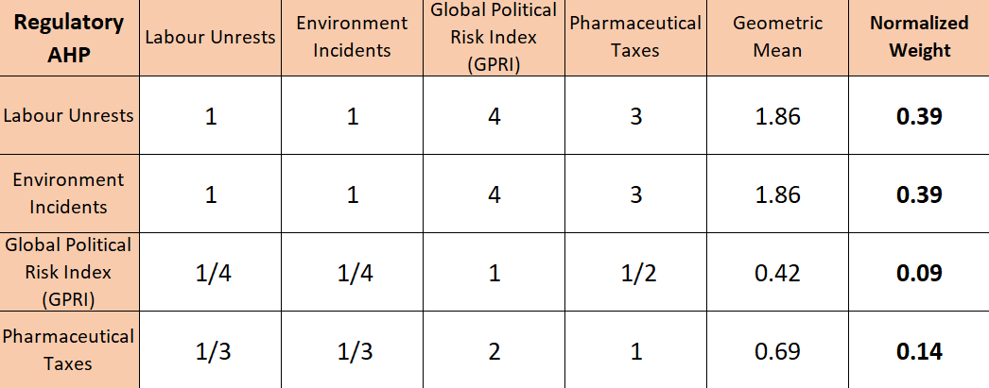
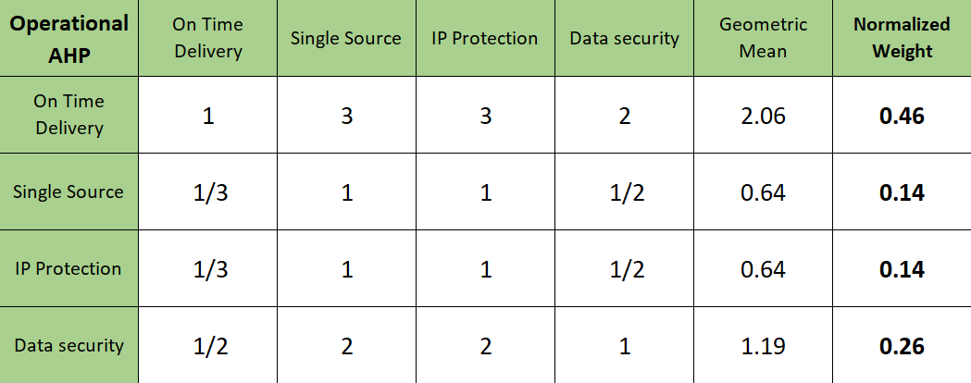
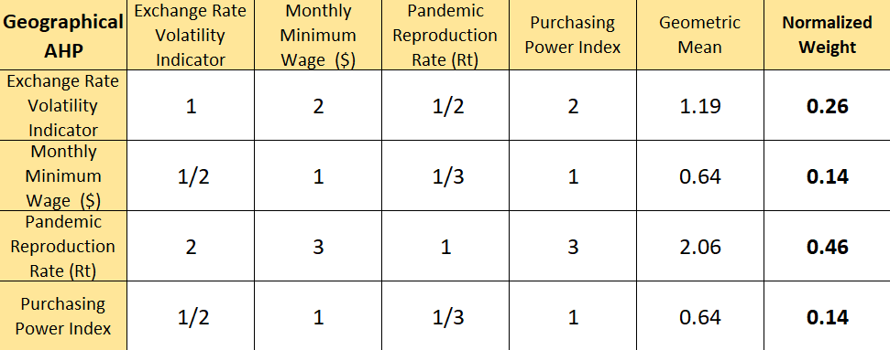
KPIs for Risk Assesment
AHP Matrices
Financial
Regulatory
Operational
Geographical

Slide 4
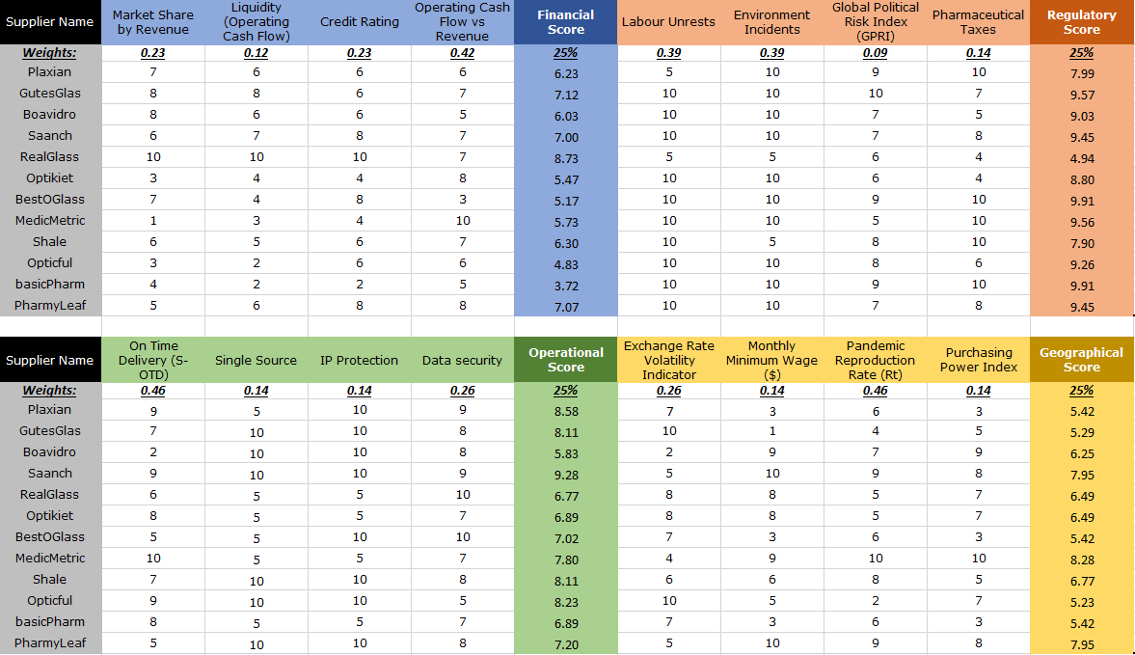
Individual KPI Score
Individual weights of each KPI has been calculated using the Analytic Hierarchy Process (AHP)
Each supplier has been scored on a scale of 10:
10 – Most Favourable
1 – Least Favourable
Composite Score is calculated using 25% weightage of each of the risk domains shown
An Exclusivity Score of +1 has been granted to every geographically essential supplier
A rating has been assigned to every supplier using the traditional notation

Slide 5
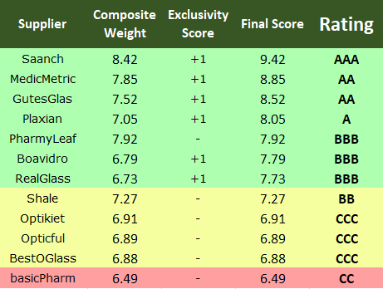
Ratings and Mitigation Strategies
Short Term
Exchange Rate Forwards
Focus on Cash Flow
Supplier Diversi-fication
Supply Chain Regionali-zation
Supplier | Composite Weight | Exclusivity Score | Final Score | Rating
EURUSD/EURCNY/EURINR
Exchange Rate Forwards
Financial
Regulatory
Financing in Foreign Currency
Netting Revenue = Expenditure
Strike Contingency Planning
Contractual Enforcing
Long Term
Netting
Revenue Stream = Expenditure Stream
Backup Supplier Contracts
3PL Diversi-fication
Lower Pandemic Reproduc-tion Rate
Suppliers in Regions with Maximum Sales
Operational
Geographical
Part Ownership of Sensitive Information
Cyber-security Frameworks
Free Trade and Low Labour Cost Regions
High Purchasing Power Countries
Sourcing Portfolio
Backup Suppliers
Riskiest Supplier

Slide 6
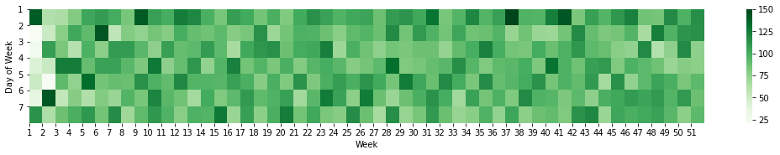

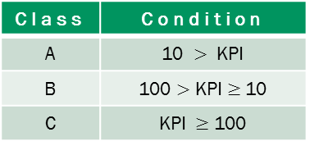
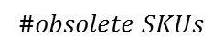
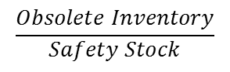
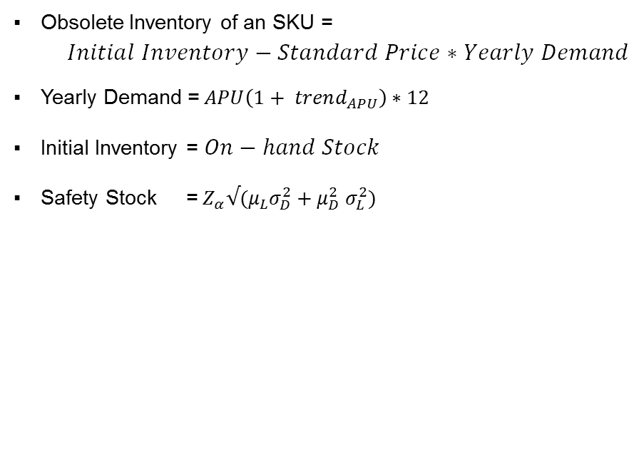
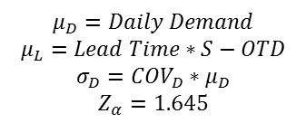
Obsolete Inventory at GlasWork
Formulae used for derivation :
Unaccounted parameters for Cost Reduction
Obsolete Inventory of an SKU = $Initial Inventory−Standard Price∗Yearly Demand$
Yearly Demand =$APU\left(1+ trend_{APU}\right)∗12$
Initial Inventory = $On−hand Stock$
Safety Stock =${ Z}_{α}√(μ_{L}σ_{D}^{2}+μ_{D}^{2} σ_{L}^{2})$
On average 94 SKUs are placed on order for replenishment daily
Day 1 - 1552
Heatmap of #orders
$$μ_{D}=Daily Demand$$
$$μ_{L}=Lead Time∗S−OTD$$
$$σ_{D}=COV_{D}∗μ_{D}$$
$$Z_{α}=1.645$$
Both Demand and Delivery Lead Time are
assumed to be normally distributed
Order Aggregation because of lacking data in terms of
Coordinated Transportation for delivering multiple SKUs
For SKUs sourced from single supplier :
Constraint for Lot Sizes to maintain Full Truck Load
Managing Joint Economic Lot Sizes for profitability
For aggregating order arrivals from multiple suppliers :
Information systems to organize dispatches based on lead times
Economic Order Quantity due to absence of data on
Holding Cost
Supplier Discounting Schedule
Defined KPI
$$\frac{Obsolete Inventory}{Safety Stock}$$
117.36 %
$$\#obsolete SKUs$$
32
Class | Condition
A | 10 $>$ KPI
B | 100 $>$ KPI $≥$10
C | KPI $≥$ 100
Ordering Fixed Cost
Potential 32 obsolete SKUs result to a Total Obsolete Inventory of $ 50,140.797

Slide 7
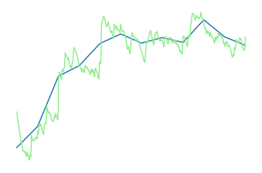

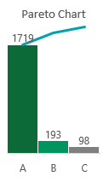
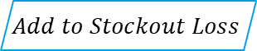
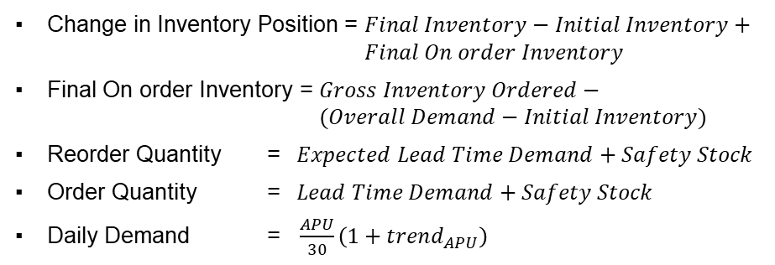
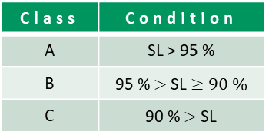

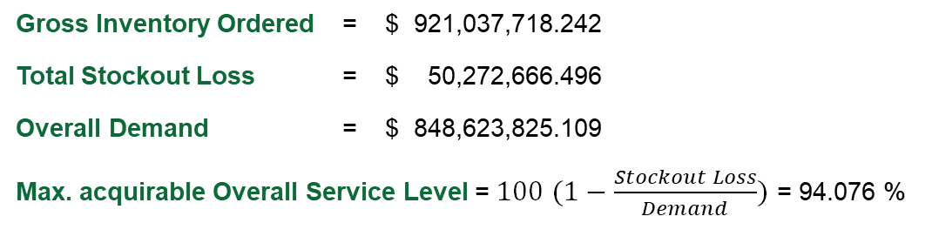
Working Capital Impact at GlasWork
Observed SCM Metrics
Inventory Management Schema for SKUs
Gross Inventory Ordered = $ 921,037,718.242
Total Stockout Loss = $ 50,272,666.496
Overall Demand = $ 848,623,825.109
Max. acquirable Overall Service Level = $100 (1−\frac{Stockout Loss}{Demand})$ = 94.076 %
97.696%
$$Inventory_{t}=Inventory_{t−1} −Demand+Arrival$$
Average
Service Level
Make 0
If negative
$$Add to Stockout Loss$$
$$\text{IF} Inventory_{t}≤Reorder Quantity$$
$$Arrival after Lead Time=Order Quantity$$
$46,008,199.786
$80,738,869.44
$118,422,092.919
Initial Inventory
Final Inventory
Final On order Inventory
For all 360 days
Do not further order $till Lead Time$
$
Formulae used for calculation :
100%
ABC Classification
92M
Change in Inventory Position = $Final Inventory−Initial Inventory+ Final On order Inventory$
Final On order Inventory = $Gross Inventory Ordered− (Overall Demand−Initial Inventory)$
Reorder Quantity = $Expected Lead Time Demand+Safety Stock$
Order Quantity = $Lead Time Demand+Safety Stock$
Daily Demand = $\frac{APU}{30}\left(1+trend_{APU}\right)$
Avg.
Class | Condition
A | SL > 95 %
B | 95 % $>$ SL $≥90 \%$
C | 90 % $>$SL
70M
85%
Daily Inventory
Level
10%
5%
24M
days
* SL – Service Level
0
137
360
Value of Assets under Inventory shall increase by $ 153,152,762.573

Slide 8
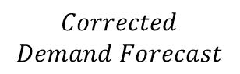
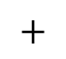
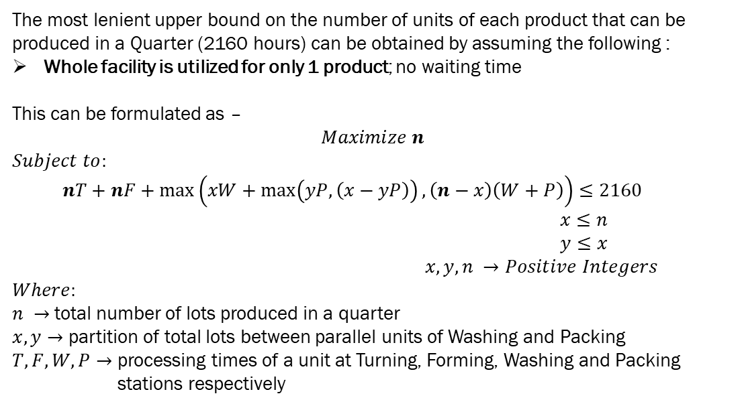
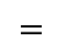
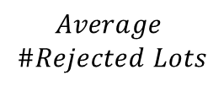
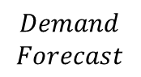
Capacity Management at Fabricadas, Chicago
$$Corrected$$
$$Demand Forecast$$
$$=$$
$$Demand$$
$$Forecast$$
$$+$$
$$Average$$
$$\#Rejected Lots$$
Estimating maximum lots of each product in a quarter
The most lenient upper bound on the number of units of each product that can be produced in a Quarter (2160 hours) can be obtained by assuming the following :
Whole facility is utilized for only 1 product; no waiting time
This can be formulated as –
$$Maximize n$$
$$Subject to:$$
$nT+nF+\max\left(xW+\max\left(yP, \left(x−yP\right)\right), \left(n−x\right)\left(W+P\right)\right)≤2160$
$x≤n$
$y≤x$
$x, y, n →Positive Integers$
$$Where:$$
$n →$total number of lots produced in a quarter
$x, y→$ partition of total lots between parallel units of Washing and Packing
$T, F, W, P→$ processing times of a unit at Turning, Forming, Washing and Packing stations respectively
Demand Projections | Q3 2020 (actual) | Q4 2020 | Q1 2021 | Q2 2021
Ampoules | 28 | 68 | 73 | 78
Vials | 20 | 35 | 45 | 50
Syringes | 24 | 49 | 54 | 59
Table 1
Approximating Capacity Requirement
Product | Tubing | Forming | Washing | Packing
Ampoules | T2 | F1 | [W2] [W4] | [P5,P6] [P5]
Q3 2020 | 168 | 336 | 504 | 672
Q4 2020 | 408 | 816 | 1224 | 1632
Q1 2021 | 438 | 876 | 1314 | 1752
Q2 2021 | 468 | 936 | 1404 | 1872
Vials | T2 | F2 | [W2] [W4] | [P1,P2] [P6]
Q3 2020 | 180 | 180 | 420 | 480
Q4 2020 | 315 | 315 | 735 | 840
Q1 2021 | 405 | 405 | 945 | 1080
Q2 2021 | 450 | 450 | 1050 | 1200
Syringe | T1 | F2 | [W1] [W3] | [P2,P4] [P3]
Q3 2020 | 144 | 216 | 432 | 576
Q4 2020 | 294 | 441 | 882 | 1176
Q1 2021 | 324 | 486 | 972 | 1296
Q2 2021 | 354 | 531 | 1062 | 1416
Table 2
Read Table 2 as :
Number of hours of Turning that Vials have to undergo in Q3 2020 :
= Corrected Demand for vials in Q3_2020 x turning time per unit of vial
= 20 x 9 → 180 hours
Possible Reasons for
Capacity Constraint
Maximum Production Units
Table 3
Insufficient Resource/ Processing time at each unit
Finite Scheduling Constraint
Product | Maximum in any Quarter
Ampoules | 60
Vials | 57
Syringe | 65

Slide 9
Capacity Constraints : Decision Tree Approach
Is available processing time at each unit enough to fulfill the production plan?
‘
Computed by solving an
Integer Programming Problem
for each product
- Table 3
No
Yes
Capacity Constraint
Maximum number of each product that can be produced in the quarter ≥ corresponding planned production
No
Yes
Capacity Constraint
Optimal schedule for the 3 products have a makespan ≤ 90 days
‘
No
Yes
Optimal schedules for each quarter computed using Johnson’s Algorithm and Campbell Dudek Smith Algorithm
Capacity Constraint
Production Plan can be executed without any constraints

Slide 10
Justification for Differing Viewpoints
Plant Controller, Fabricadas
VP Operations, MediCrystals Co.
Plans a CHASE DEMAND STRATEGY for production in the upcoming quarters which attempts to match output with fluctuating demand
Constraints observed:
Demand for ampoules exceeds maximum production limit in Q4 2020, Q1 2021 & Q2 2021
No optimal schedule fulfils demands of vials & syringes together in Q2 2021
Plans a LEVEL CAPACITY STRATEGY for production where maximum possible units of each product is produced in a quarter and this output stays constant irrespective of the demand
May increase inventory → justified as probability of overstocking is very low given almost guaranteed surge in demand for the glass products when COVID-19 vaccine is out in the market
Can overcome the constraints that the Plant Controller is seeing
Avoids costs incurred by the ineffective use of capacity at periods of low demand, by the need to recruit or lay off staff, by learning-curve effects, and by a possible loss of quality.
Products | Q3 2020 | Q4 2020 | Q1 2021 | Q2 2021
Ampoules | Yes | No | No | No
Vials | Yes | Yes | Yes | Yes (No)
Syringes | Yes | Yes | Yes | No (Yes)
Recommendations
Short term
Long term
Avoid excessive stress on the production capacity during demand peaks
Expand Overall Worktime
Ampoules and Vials share common Washer Stations; Former has higher demand
Reduce the time duration of maintenance shutdowns
Relax capacity pressure on Washer units
Reduce the 35% observed rejection
Level capacity strategy is the best strategy in this problem
Operate weekend shifts to increase the capacity
Shut down the vial line when its demand is fulfilled to expand ampoules output
Integrate a
robust ERP system
to increase responsiveness & reduce maintenance time
Recruit more labor force to enable parallel functioning of units of the same process
Improve
quality control strategies to reduce net rejected lots of each product
Notes:
Shut down vials line as soon as its 4 quarter demand is met :
Justification for checking the lower bound on makespan to determine if there is a capacity constraint

Slide 11
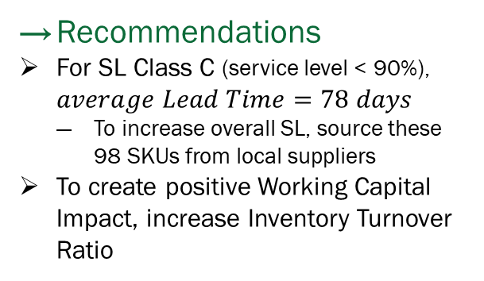
Conclusion
Supplier Risk Management
Inventory Management
Capacity Management
Seven essential suppliers have been recommended based on AHP Risk Assessment
$ 50,140.797
There exists a capacity constraint when Chase Demand Strategy is adopted
Total Obsolete Inventory
From 32 obsolete SKUs
basicPharm is the riskiest supplier owing to inefficiency in financial, operational and geographical risk domains
$ 153,152,762.573
Level Capacity Production Plan maximizes the capacity utilization
Working Capital Impact
Increase of Assets under Inventory
Recommendations
Devise a forward contracts portfolio to ensure zero downside due to foreign currency risk exposure
Supplier diversification & regionalization
3PL diversification between air, ocean and ground is essential for mobility
Recommendations
For SL Class C (service level < 90%), $average Lead Time=78 days$
To increase overall SL, source these 98 SKUs from local suppliers
To create positive Working Capital Impact, increase Inventory Turnover Ratio
Recommendations
Expand available processing time
- Weekend shifts
- Methods to reduce maintenance time
- Identify reasons for unplanned shutdown
Enable parallel functioning of process units
Better quality control measures

